Slide 1
UNIT--IV
CLOUD COMPUTING TECHNOLOGIES AND APPLICATIONS

Slide 2
CONTAINS
Cloud Content Delivery Network Services
Multi-CDN.
Features of Meta CDN
Mobile Cloud Computing
InterCloud Issues.

Slide 3
CLOUD CONTENT DELIVERY NETWORK SERVICES
Content Delivery Network :- CDN is a software service which solves distributed content delivery problems across all geographical regions
Examples :- AWS CloudFront is one of the popular content delivery service used by AWS business application users.
Akamai
EdgeCast
Level 3
Incapsula
Instart Logic
Aryaka Networks.
A content delivery network (CDN) refers to a geographically distributed group of servers which work together to provide fast delivery of Internet content.
A CDN allows for the quick transfer of assets needed for loading Internet content including HTML pages, javascript files, stylesheets, images, and videos. The popularity of CDN services continues to grow, and today the majority of web traffic is served through CDNs, including traffic from major sites like Facebook, Netflix, and Amazon.

Slide 4
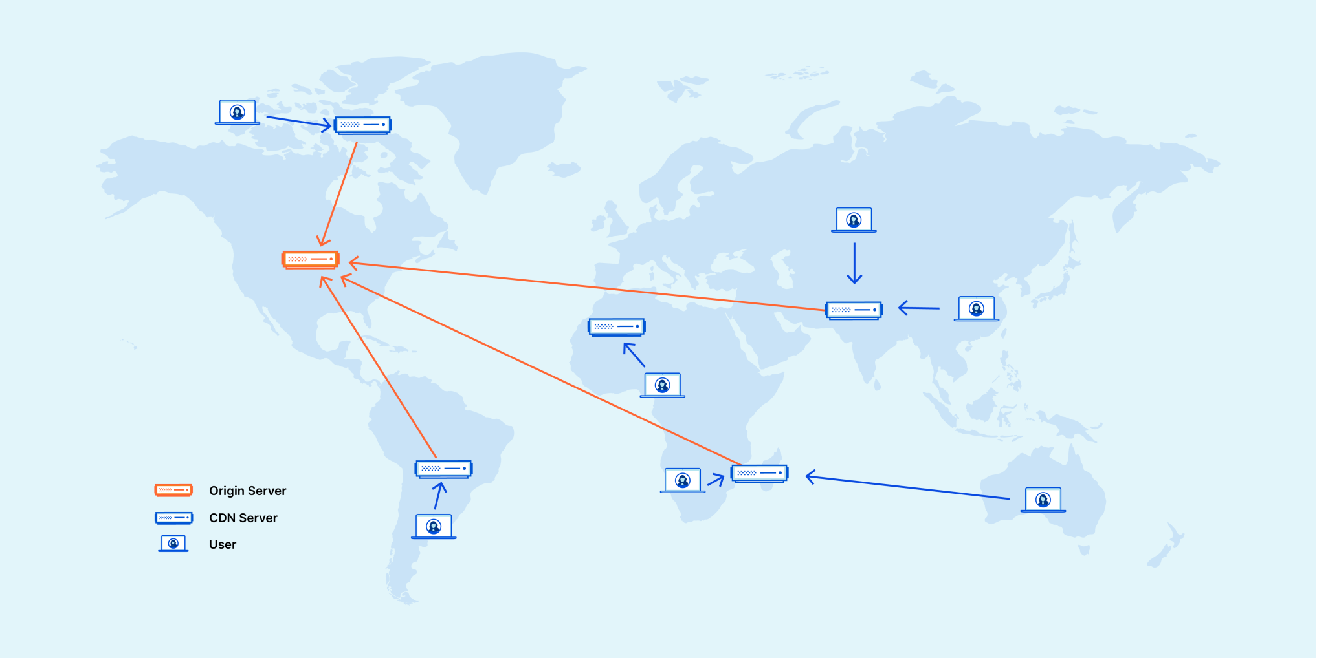
In order to improve speed and connectivity, a CDN will place servers at the exchange points between different networks.
2. A CDN makes a number of optimizations on standard client/server data transfers. CDNs place Data Centers at strategic locations across the globe, enhance security, and are designed to survive various types of failures and Internet congestion.

Slide 5
BENEFITS OF USING A CDN
1. Improving website load times - By distributing content closer to website visitors by using a nearby CDN server (among other optimizations), visitors experience faster page loading times. As visitors are more inclined to click away from a slow-loading site, a CDN can reduce bounce rates and increase the amount of time that people spend on the site. In other words, a faster a website means more visitors will stay and stick around longer.
2. Reducing bandwidth costs - Bandwidth consumption costs for website hosting is a primary expense for websites. Through caching and other optimizations, CDNs are able to reduce the amount of data an origin server must provide, thus reducing hosting costs for website owners.
3. Increasing content availability and redundancy - Large amounts of traffic or hardware failures can interrupt normal website function. Thanks to their distributed nature, a CDN can handle more traffic and withstand hardware failure better than many origin servers.
4. Improving website security - A CDN may improve security by providing DDoS mitigation, improvements to security certificates, and other optimizations.

Slide 6
MULTI-CDN
If your business application needs are purely global and require multiple servers across the globe to give each user a faster website loading experience irrespective of their locations, then this concept of Multi-CDN comes into pictures.
META-CDN :- This is a company which provide multi-CDN.
It combines existing CDN providers into one huge global network.
It dynamically combines and optimizes all major cloud service providers and infrastructures providers quickly and securely speed up the Web contents to users.

Slide 7
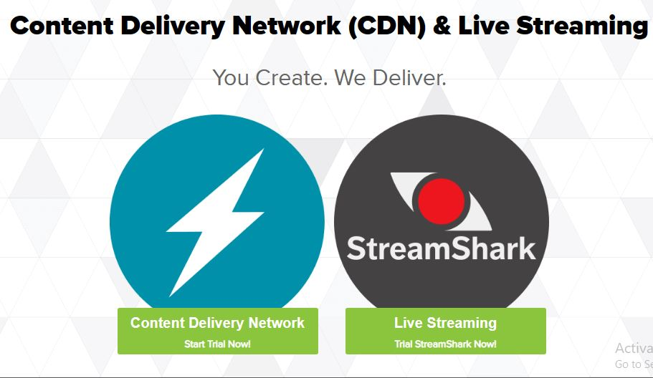

Slide 8
KEY FEATURES OF METACDN
Global Presence :- The business application of any user gets massive amount of CDN locations which is not possible with one single CDN provider.
Faster Content delivery :- MetaCDN always selects the best optimal server for individual users. If there are multiple CDN providers in one region, Users will always get the content from the faster one within that region.
Always uptime :- MetaCDN gives guarantee of 100% service uptime: because if one CDN network goes down, MetaCDN immediately routes the traffic through another provider.

Slide 9
MOBILE CLOUD COMPUTING
Mobile cloud computing is a concept related to cloud computing and it brings services such as on-demand access and no on-premise software.
Mobile Computing uses network capabilities alone to deliver the desired service to customers and charges for their use.
It could permit the user to reserve network bandwidth.
MCC is a new paradigm for mobile applications where the data processing and storage are moved from the mobile device to cloud.
The mobile phone world is dependent on two factors
i. Network stability
ii. Handset availability.
Mobile phone do not have adequate processing power or memory to support huge amount of data. Cloud computing seems to be the great idea solution for these mobile phone users.

Slide 10
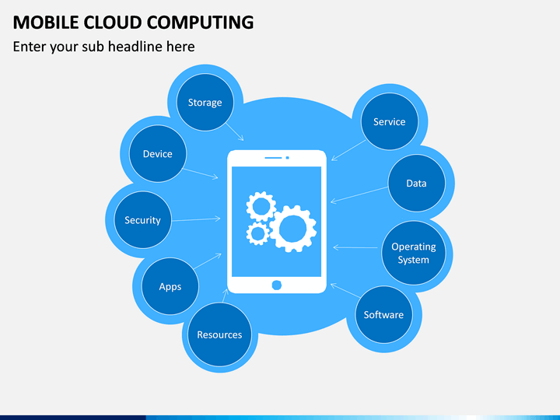

Slide 11
Why Mobile Cloud Computing ?
Following are some significant limitations with mobile devices, which can be overcome with cloud computing.
Limited processing :- Mobile phones do not have adequate processing power or memory to support huge amounts of data.
Loss of Connection:- Due to the mobility of the clients and the wireless network setup, mobile clients can be removed temporarily from the previous connected network and may enter another network:, therefore service or responses may fail to be delivered to their destination.
Bandwidth/Latency :- Cell networks have inadequate bandwidth and are often billed on the basis of the amount of data transferred.

Slide 12
INTERCLOUD ISSUES
Intercloud is a global “ Cloud of Clouds” which describes a service pattern and agreement among cloud providers to build interconnected cloud services for poviding flexibility and enhanced experience to users.
Grid of Clouds :- When more providers work and operate together is called a grid of clouds.
Advantage :-
The key benefits of InterCloud is that it solves cloud interoperability issues.
If the Vendor lock-in problems occurs, it can be resolved this issues with the help of Intercloud.

Slide 13
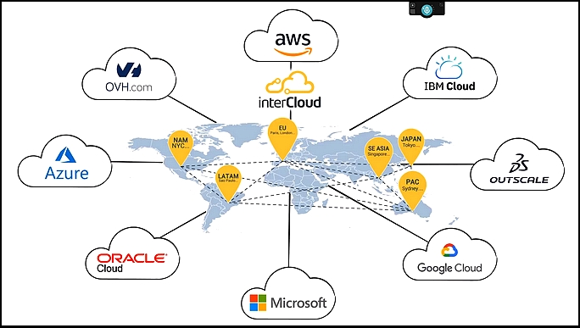
SIMPLE EXAMPLE OF INTERCLOUD

Slide 14
CHALLENGES IN INTERCLOUD IMPLEMENTATION
Cloud providers face some specific challenges when trying to implement Intercloud are as follows
Lack of Standards :- Since cloud computing standards are evolving and research is ongoing on various developing standards, Cloud resources such as virtual machine provisioning , Object and Block storage cannot be standardized for all cloud providers in InterCloud
In terms of conventions, addressing, messaging, etc. proper management is required to solve this challenges.
2. API translation :- There should be commond interface for all cloud providers that are parts of InterCloud. This common interface should be responsible for API or other service request translations between two providers.

Slide 15
CHALLENGES IN INTERCLOUD IMPLEMENTATION
3. Security :- Following are some possible security-related threats when InterCloud starts working
Task and services migration from one cloud provider to another provider
The question about who should monitor the common administration among all clouds.
Managing public key infrastructure of InterCloud.
Agreement on Common encryption and decryption protocol for all cloud providers.

Slide 16
THANK YOU

